Slide 1
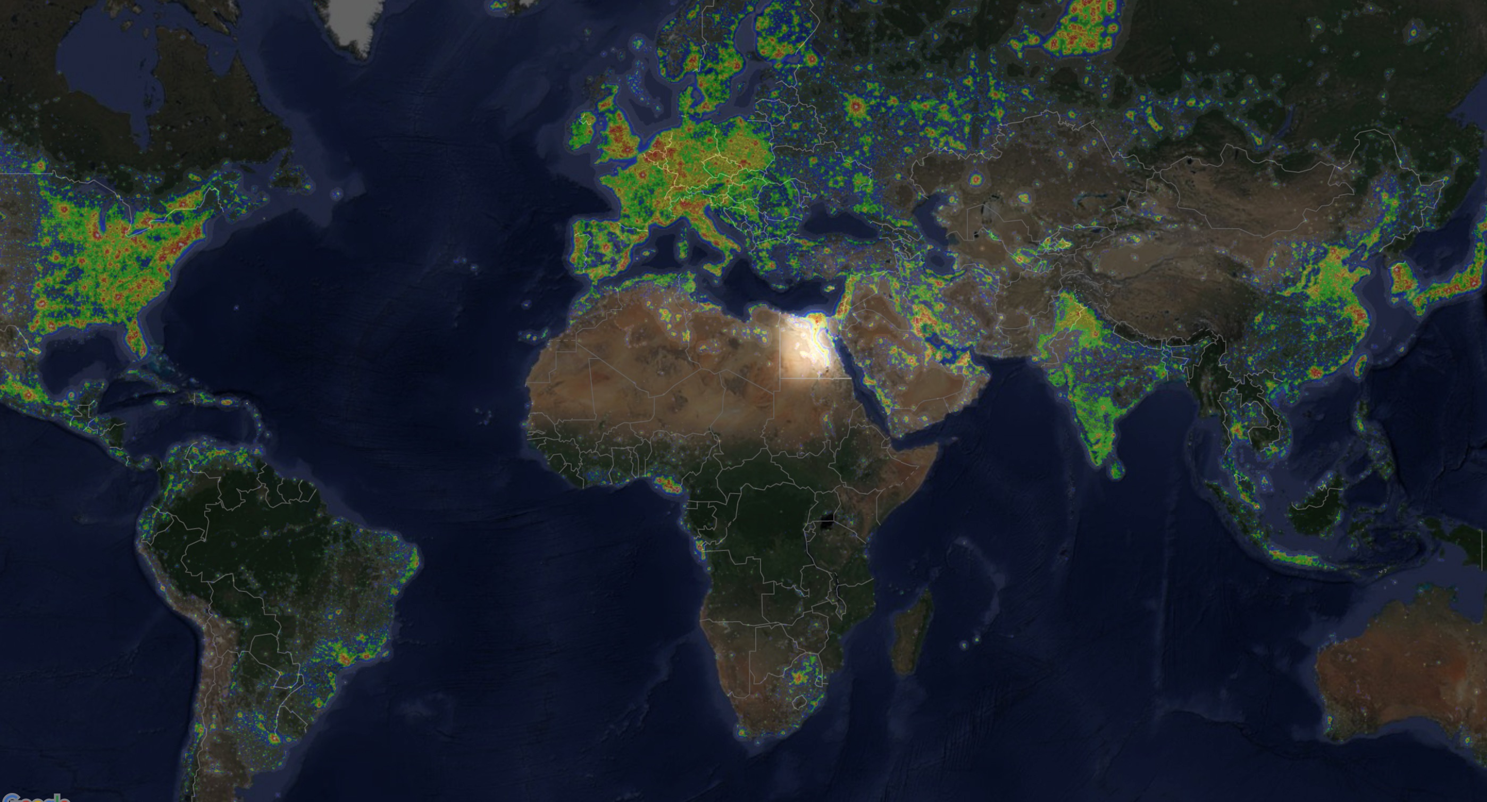

Invest in
Egypt
2nd Meditterranean and African Breakfast
Wednesday, 11th of April, 2018

Slide 2
Potentiel Africain
Taux de croisssance de PIB à atteindre 4,3% en 2018
Changement
Pays ciblés
Secteurs
ciblés
Taux dinvestissement de capitaux a augmenté de 31,9% en 2016
Elle represente 30% du business en 2016

Slide 3
L’Egypte comme hub entre l’Europe et l’Afrique
1ère destination d’IDE en Afrique
Rapport de rand Merchant
Ou investir en Afrique 2018
2ème rang de beneficiaires d’IDE
2017 World investment Report
UNCTAD

Slide 4


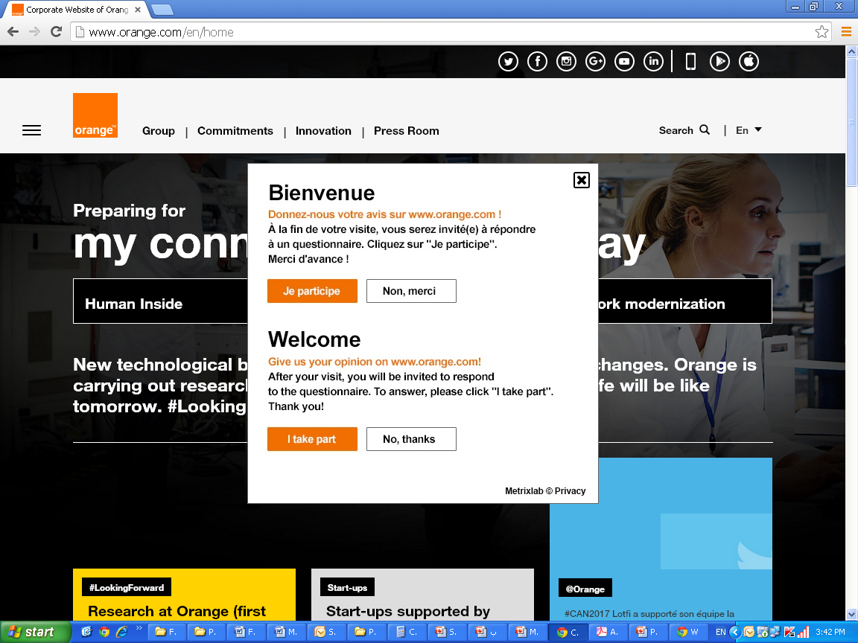
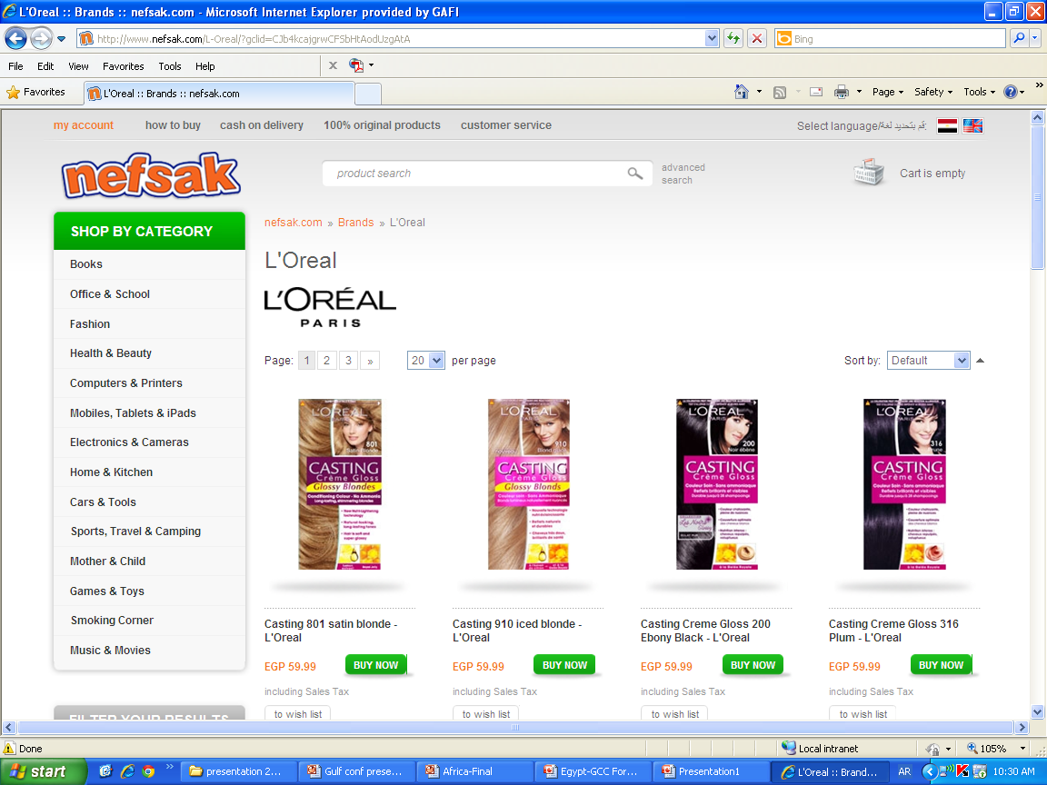




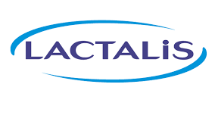
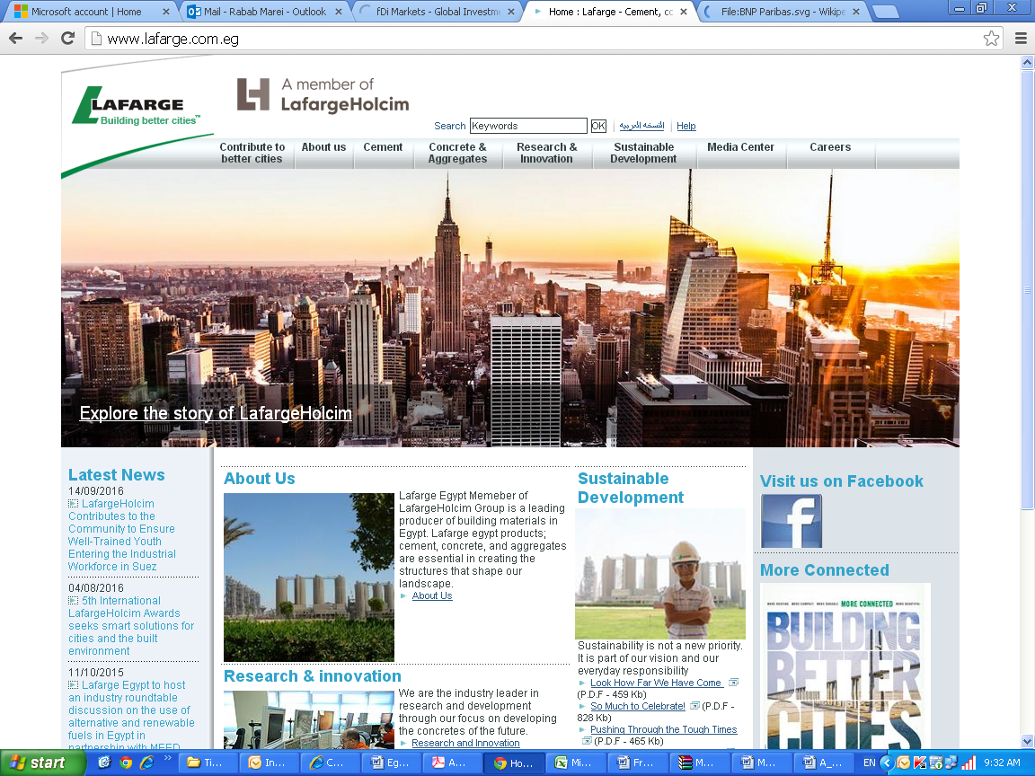






La France en Egypte
Plus de 160 entreprises
Plus de 4 milliards d’euros
Secteurs Variés

Slide 5
Accords bilateraux et multilatéraux
Signés par l’Egypte
l’Europe
1er partenaire commercial,
1er investisseur,
1er bailleur d’aide au développement
▪ Accord d'association Égypte-UE
▪ Le Marché commun de l'Afrique orientale et australe (COMESA)
▪ L'accord de libre-échange entre l'Égypte et l'association européenne de libre-échange
▪ L'association européenne de libre-échange (Islande, Lichtenstein, Norvège, Suisse)
▪ Les zones industrielles qualifiées (ZIQ)
▪ L’accord de libre-échange d'Agadir
▪ La Grande zone arabe de libre-échange (GZALE)
▪ La zone arabe de libre-échange (ZALE)
▪ L'accord de libre-échange entre l'Égypte et la Turquie
▪ L'accord de libre-échange entre l'Égypte et le MERCOSUR
And more …

Slide 6
Accords bilateraux et multilatéraux
Signés par l’Egypte
Landmark Tripartite Agreement between COMESA,
SADC and the EAC
▪ C’est ainsi que le 10 juin 2015, à Charm-El-Cheikh, le Marché commun pour l’Afrique de l’Est et du Sud (COMESA), la Communauté de l’Afrique de l’Est (CAE) et la Communauté de Développement de l’Afrique australe (SADC) ont décidé de fusionner pour former le plus grand espace de libre-échange en Afrique.
Plus Grand Bloc Commercial en Afrique
$1,2 trillion
26 pays
620 millions de consommateurs
And more …

Slide 7
L’Egypte comme hub entre l’Europe et l’Afrique
Vaste Réformes
Engagement au plus haut niveau politique
Réformes Administratives
Investment Réformes
Doing Business Réformes
Réformes législatives
Infrastructure avancé
FMI
Groupe de la Banque Mondiale

Slide 8
Nouvelle loi d’investissement
Conseil Suprème de l’investissement
17 Decisions de reformes lors de sa 1ère reunion
Nouvelle loi d’investissement
Introduction du Centre de Services aux investisseurs
www.miic.gov.eg
www.gafi.gov.eg
Garanties et Incitations
Investment map portal www.investinegypt.gov.eg
And more …

Slide 9
Egypt : Your Investment Destination
100 Million
Total Population
One of the best economies in IRR for foreign investors
Competitive cost of production factors
Quality cost competitive work force
Diversified economy with various economic sectors
Resilient economy to external & internal shocks
Continuous investment climate reforms
Supportive legislative environment
Improving infrastructure
1.6 Billion consumers
Through preferential free trade agreements
22.5% Corporate tax
With no double taxation in over 90 countries according to tax treaties
Strategic location
@the heart of the world trade

Slide 10
Promising Sectors
Agribusiness
Engineering and Electronics
Health care
Logistics
Mining
ICT
Petrochemicals
Pharmaceuticals
Real estate and construction
Retail
Textile
Tourism
Renewable energy
Automotive

Slide 11
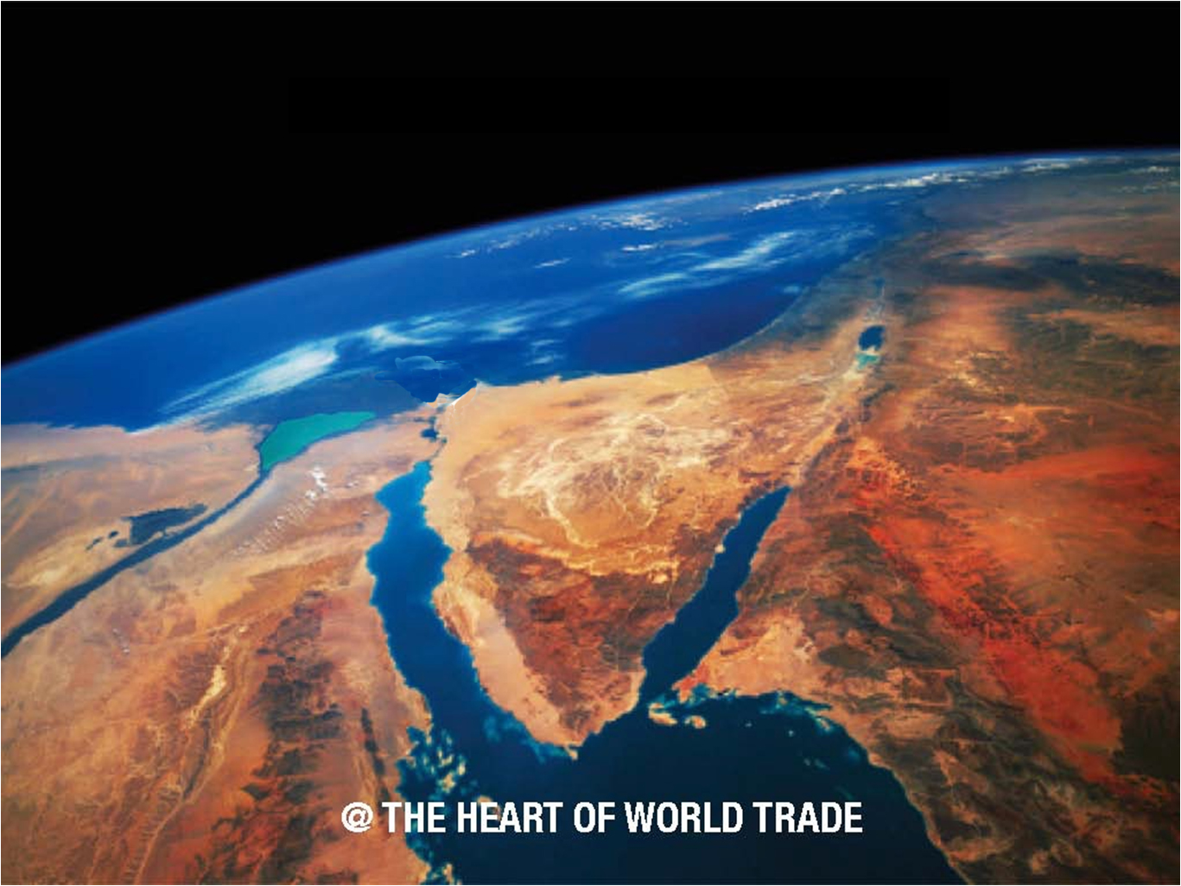
Mega projects
The Suez Canal Economic Zone
SCZone

Slide 12
Mega projects
A new chapter in the economic development of Egypt.
The Suez Canal Economic Zone
Ain Sokhna
Creation of one of the largest industrial and port complexes globally. Industrial Development of over 16,250 hectares supporting light medium and heavy manufacturing activities, as well as commercial and business activities.
East Port Said
Development of East Port Said Port into a major transphipment hub and a thriving gateway port.
4,000 hectares earmarked for light and medium manufacturing, commercial and business activities and a new urban area.
West Qantara
Administrative center of Suez Canal zone. Specialized clusters for R&D activities in both ICT and renewable energies in Ismailia City and also in East Ismailia.
Agri-processing and related logistics center, dry port and other light manufacturing activities supported at Qantara.
Development of urban areas at Qantara and New Ismailia City – capacity to host over 350,000 residents.
All imports are exempted from duties and sales
One Stop Shop to ease all procedures
6 ports under the SCZone project

Slide 13
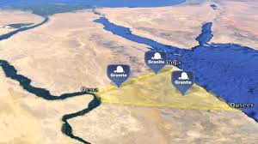
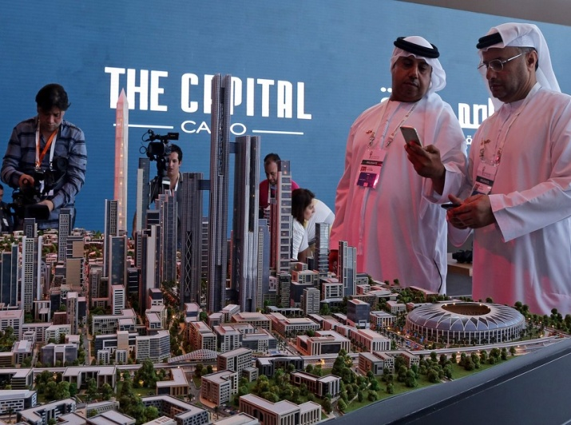

Mega projects
Golden triangle
The Capital Cairo
1.5 Million Feddan
Three main mining anchors in Upper Egypt (Qena,Quseir &Safaga) ( limestone, phosphate rocks, glass sand, shale rocks, and gold) generating multiple industrial zones with total area of 840 thousand feddans, developing the area for tourism, industrial, commercial and agriculture opportunities.
A large scale project located 45 km east of Cairo aiming at reducing pressure on Greater Cairo.
The masterplan is to create a global city with smart infrastructure for Egypt's future, which will provide a multitude of economic opportunities and offer a distinct quality of life.
Expanding the footprint of Egypt beyond traditional Nile Valley and Delta region.
Developing the land for agriculture associated activities like logistics and agro industries.
Project is planned to be implemented on 3 phases.

Slide 14
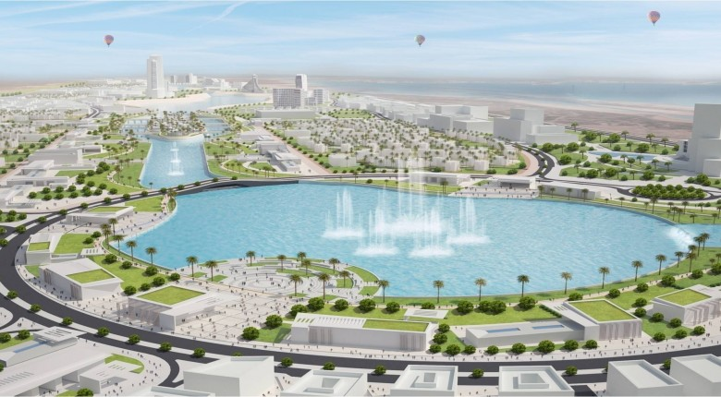

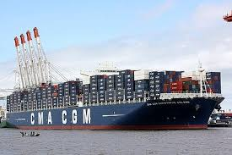
Mega projects
Alamein new city
Damietta Furniture City
Damietta Logistics center for grain
A new model for Egyptian coastal cities that achieve integrated development
The city is famous for witnessing several World War II battles
The project is on the Northwest coast and represents approximately 12.8% of the total area of Egypt. 48000 feddans. The project will attract investments in the tourism, agriculture, industrial, commercial, and educational sectors.
Cluster for funiture built on 333 feddans, includes 2000 workshops,55 factories, aiming at modernizing Egypt’s furniture industry in addition to stimulating exports.
The logistics center will be located on 3,350 square kilometers of land in Damietta in the Delta area.
The project includes building storage silos and two new quays that will be able to receive large shipments at Damietta Port.

